Slide 1
Blind Sight
LIDAR Motorcycle Blind Spot Detection System
David Wang, Iftiak Ahmed, Kevin Campoverde, Li Ting Melisa Chen Chen

Slide 2

Agenda
Project Motivation
Project Approach
Coding Methodology
CAD Design Methodology
Testing
Future Plans

Slide 3
01
Project Motivation

Slide 4




Project Motivation
Team member rides a motorcycle daily.
80% of delivery drivers prefer bikes, e-bikes, or motorcycles.
These dangers faced
High-Speed Traffic
Impaired Drivers
Dooring Incidents
We want to develop a tool that can help assist in the workload in operating such vehicles
Notes:
These dangers face contributing to 26% of traffic deaths involving cyclists. (SOURCE: OLD SLIDE. HAVE NO FRICKEN IDEA WHO WROTE IT)

Slide 5
02
Project Approach

Slide 6

Project Approach
Needed to adequately alert riders without interfering motor controls.
Placement of device module as well as LEDs.
Device module needed to be placed low enough to allow LIDAR sensors to detect smaller sized vehicles
Researching market to determine optimal placement for device, the needs and additional wanted features.

Slide 7
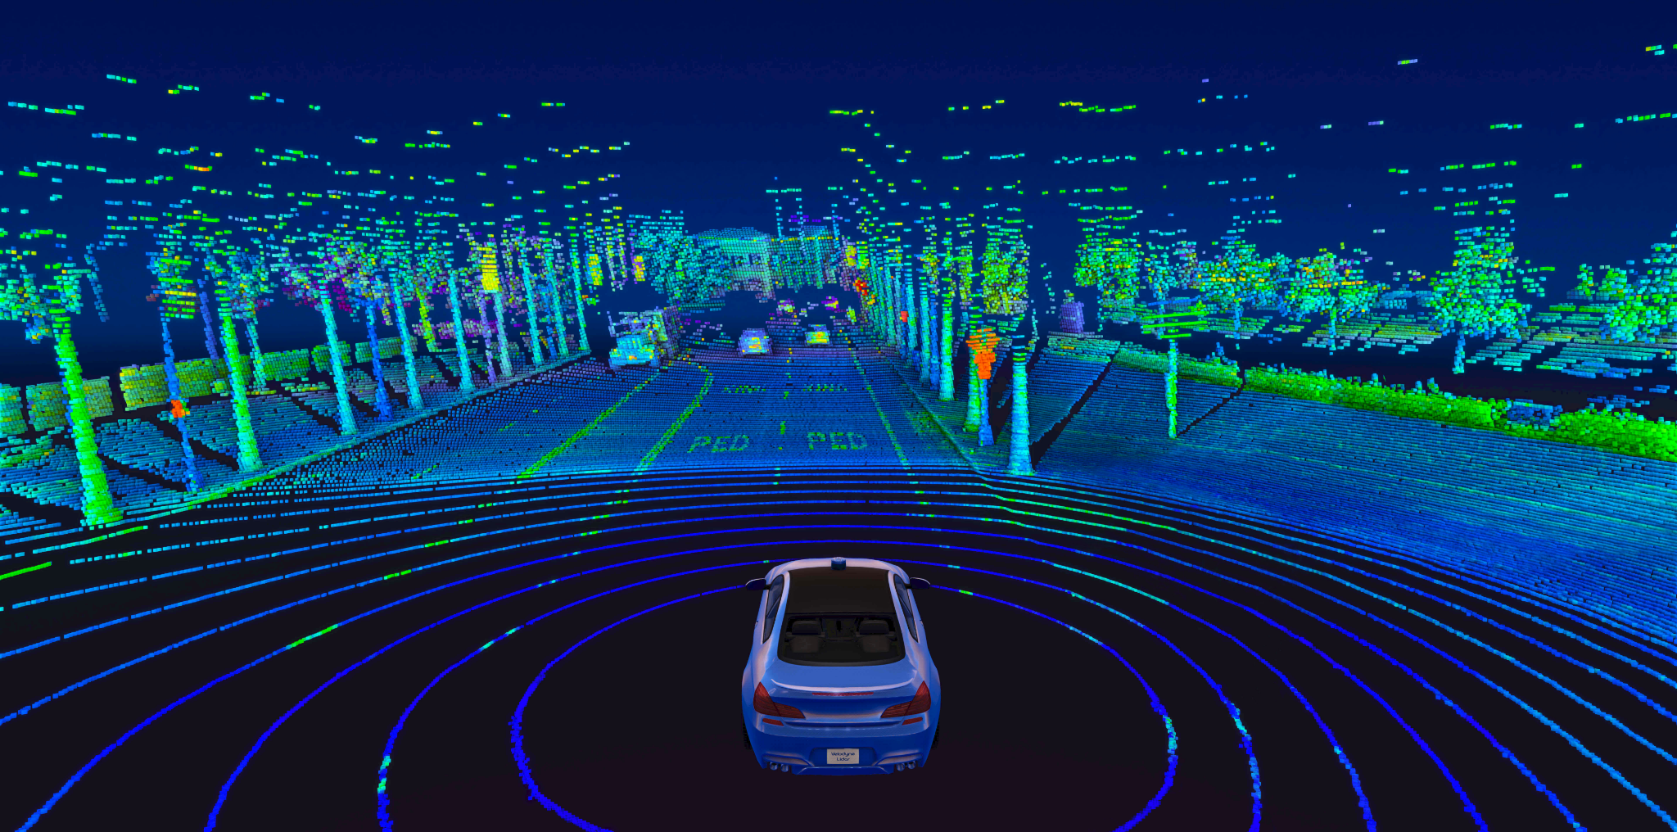
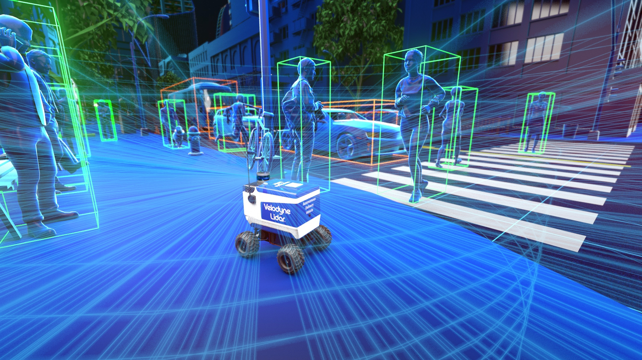
What are LIDAR sensors?
LIDAR stands for Light Detection and Ranging
A method of remote sensing that uses laser light pulses to collect spatial information regarding a specific region or object.
Unlike radar that uses radio waves, the light pulses in LIDAR allows for higher resolution and better accuracy.

Slide 8
03
Coding Methodology

Slide 9

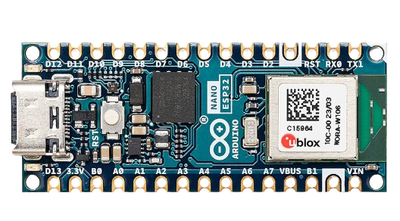
Software development
Utilizing the Arduino environment for programming the Nano ESP32 microcontroller.
microcontroller retrieve data from a LIDAR module.
Calculating warning statuses based on distance measure by the LIDAR modules.
Activating RGB LEDs to visually convey warnings corresponding to the calculated statuses.

Slide 10
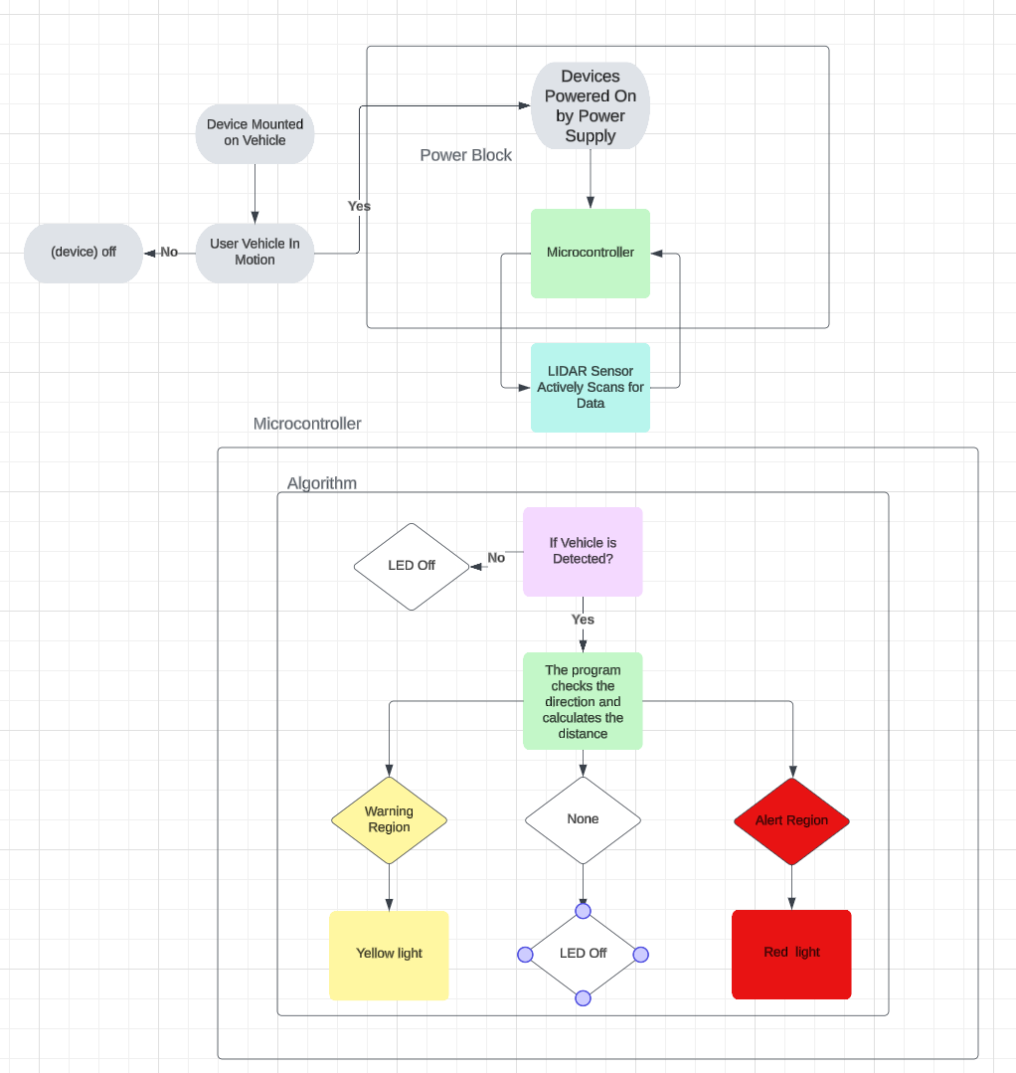
Programing breakdown
The device activates when the motorcycle starts.
The LIDAR module measures object distances behind the motorcycle in three directions: Left, Right, and Middle.
Distance data is sent to the microcontroller.
LEDs light up based on direction of the approaching vehicle:
Left LED if the vehicle is on the left side.
Right LED if the vehicle is on the right side.
Both LEDs if the vehicle is detected by the middle LIDAR.
Warning zone: 4 to 8 meters.
Alert zone: 0 to 4 meters.

Slide 11
04
CAD Design Methodology

Slide 12
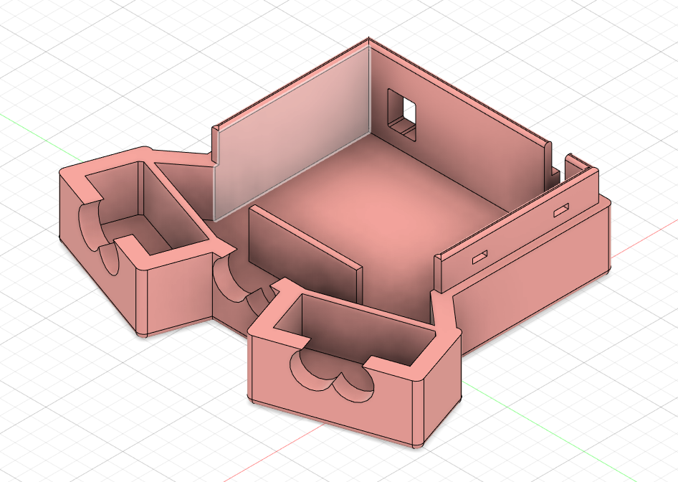
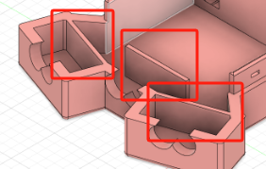

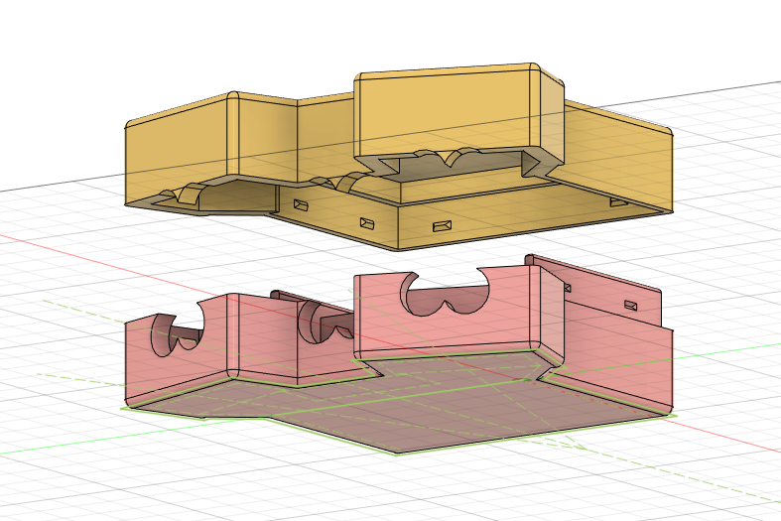
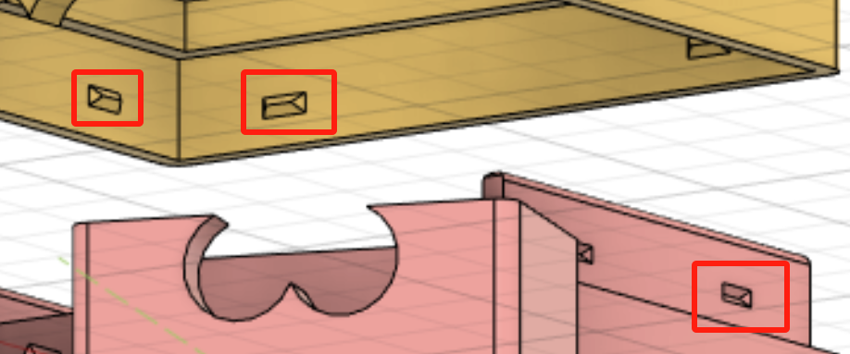
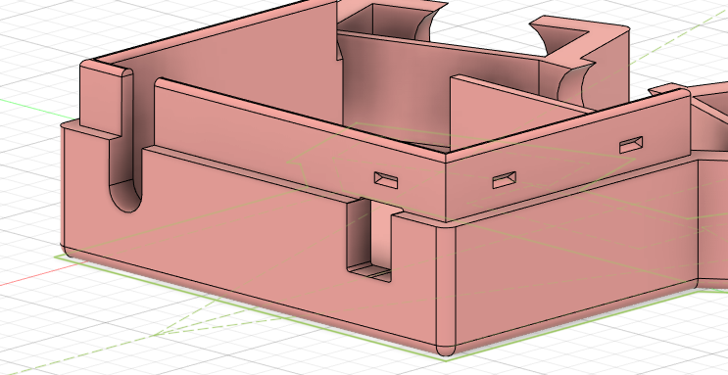
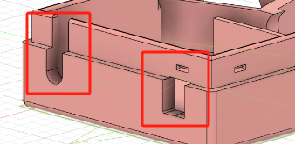

Slide 13
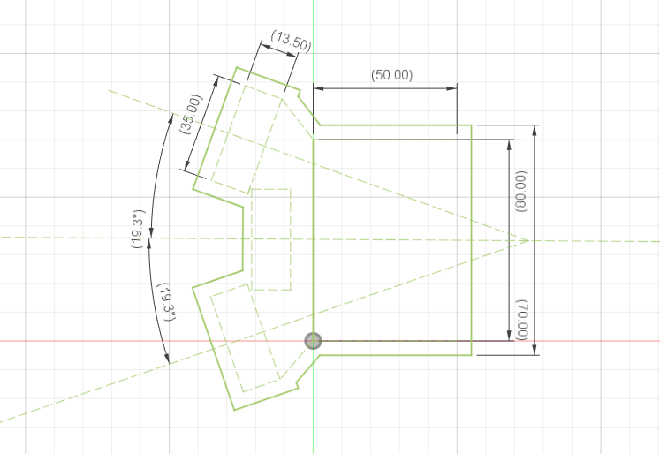
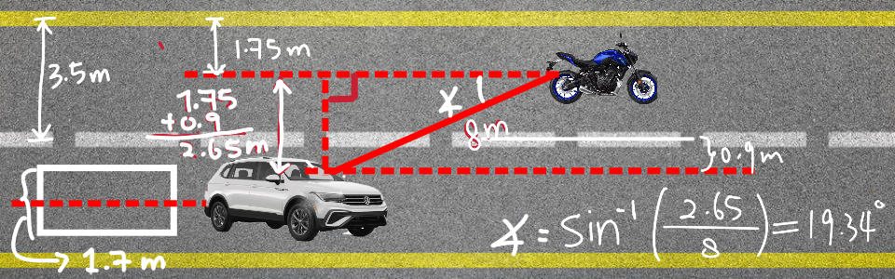
Angle decision for sensor

Slide 14
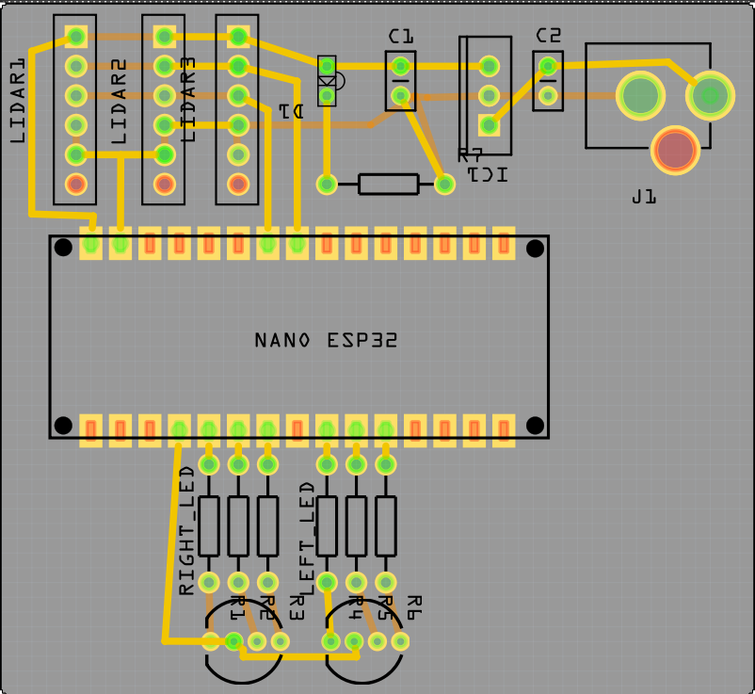
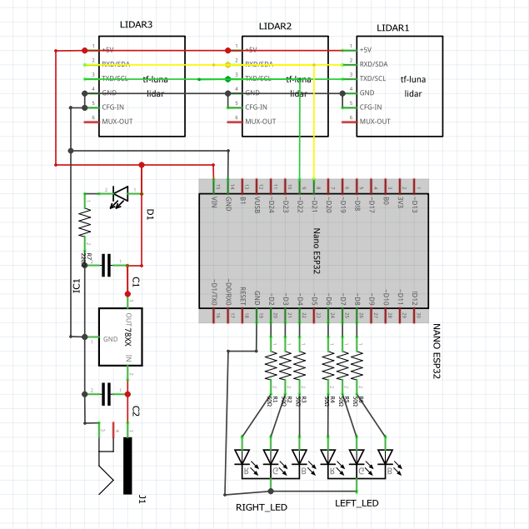
Schematic and PCB layout

Slide 15
05
Testing Methodology

Slide 16
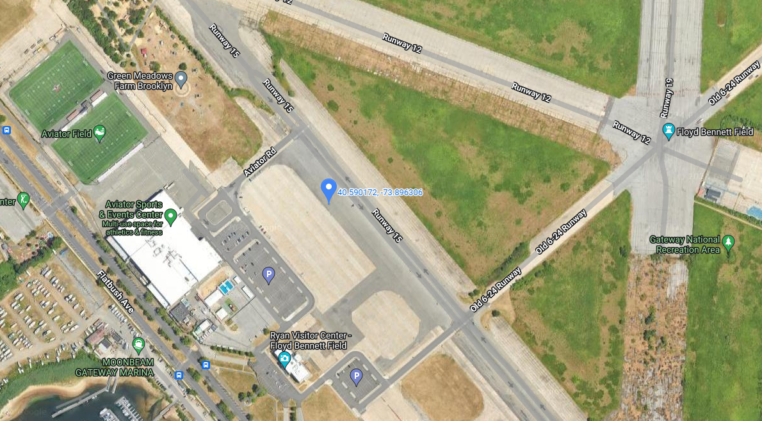
Testing Location
Empty Lot by Aviator Sports & Events Center by Floyd Bennett Field (3159 Flatbush Ave, Brooklyn, NY 11234)
Chosen due to:
Proximity to team members.
No traffic.

Slide 17

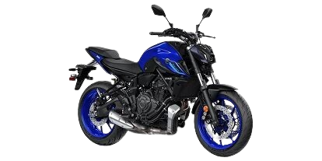
Test Vehicles
2023 Volkswagen Tiguan 2.0T SE
2023 Yamaha MT-07

Slide 18
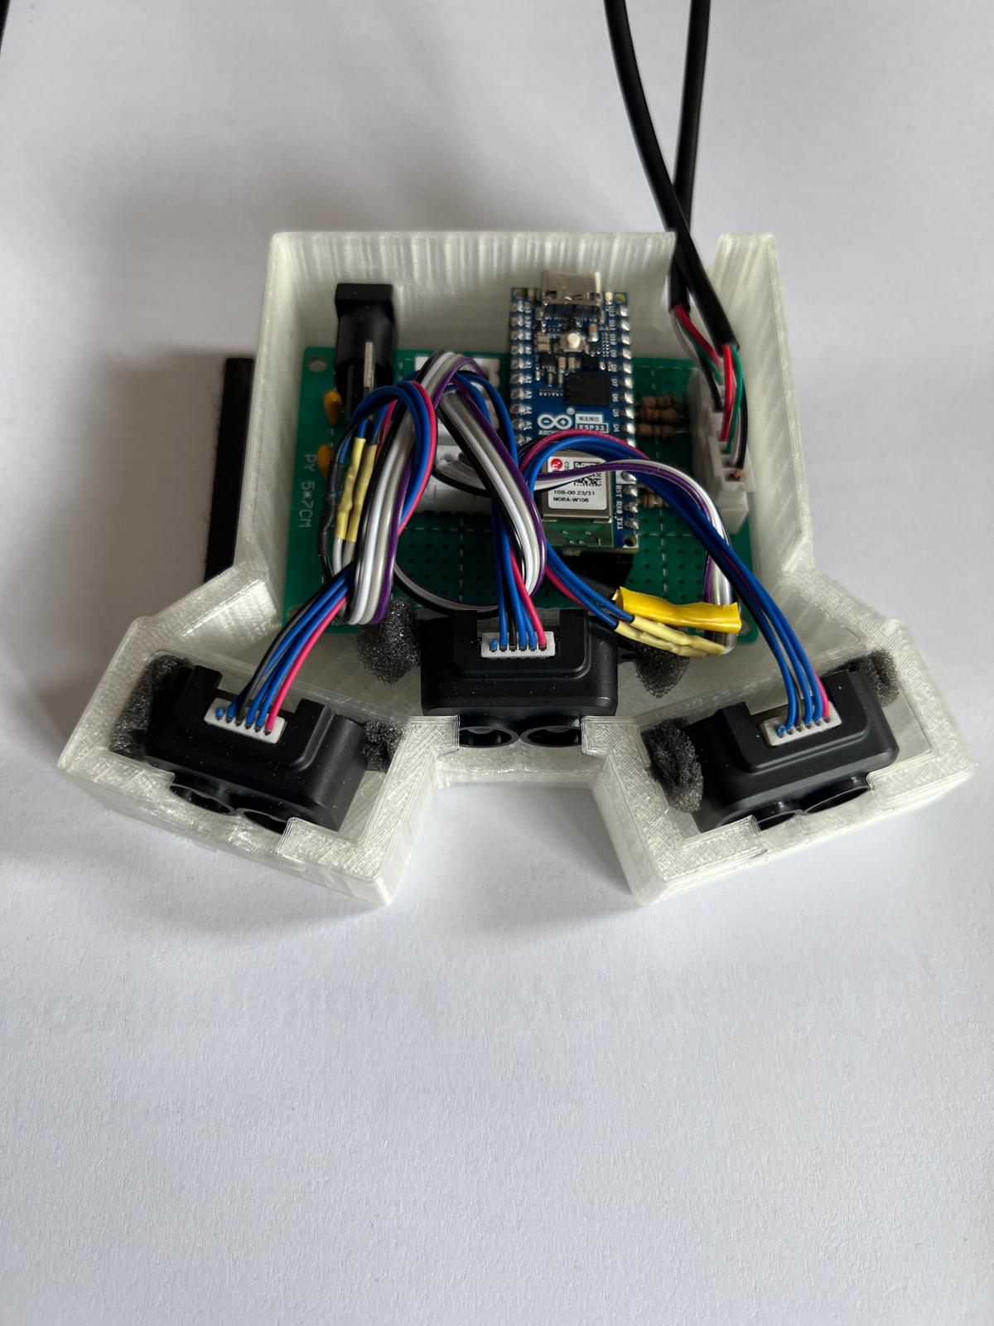
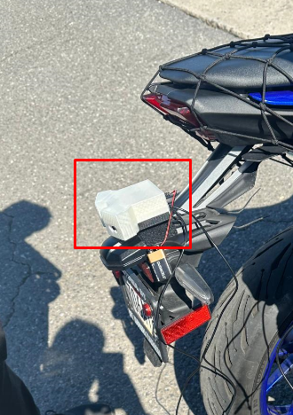
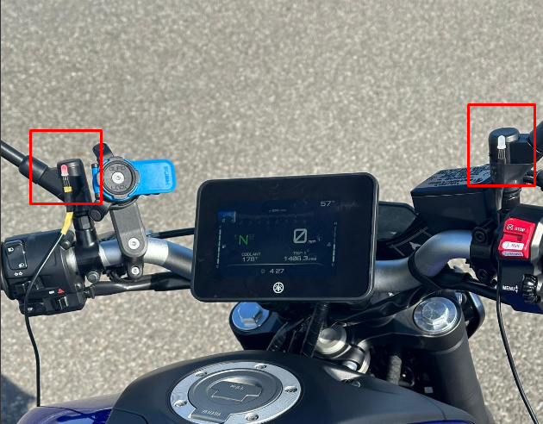
Device Setup

Slide 19

Testing Methodology
Test device that it operates within current design expectations.
Right, Left Blind Spot LED alerts biker when vehicle enter both in alert and danger region.
LED lights are activated when vehicle is present behind biker.

Slide 20
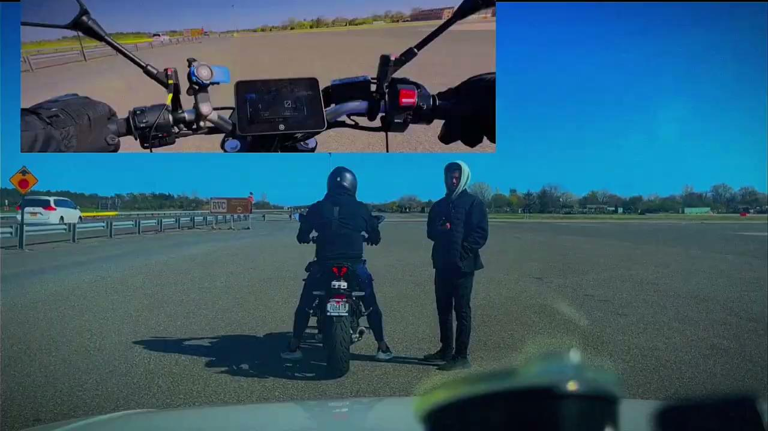

Slide 21
06
Future
Plans

Slide 22
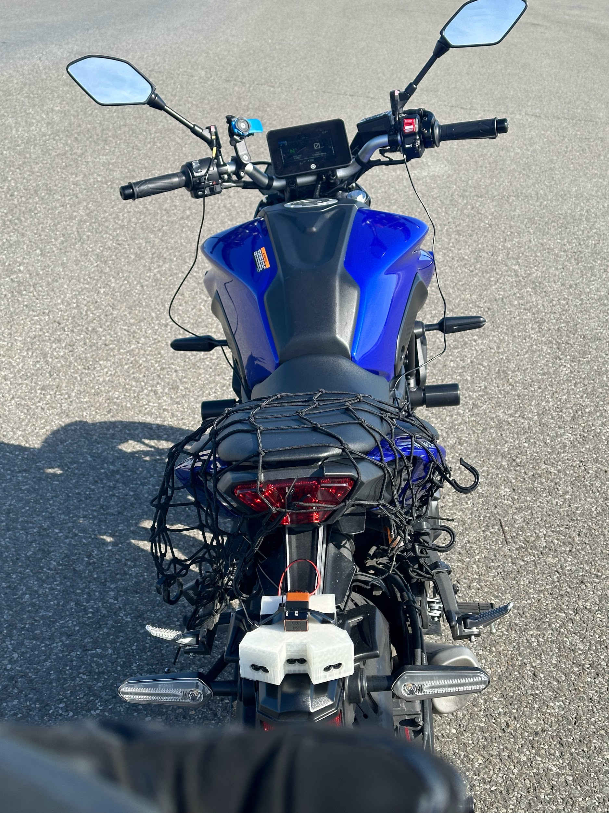
Future Plans
Testing under weather conditions.
Adding more sensors to provide a 360° collision detection device
Incorporate a audio warning that would be safe to implement.
Such as how airplane cockpits have audio warning in addition to visual warnings.
Implementing a auto braking feature if a 360° FOV module existed for the project.

